Slide 1

Spatial Data Management using Big Data Platforms
Yao-Yi Chiang
Computer Science and Engineering
University of Minnesota
yaoyi@umn.edu
CC-BY
Attribution

Slide 2
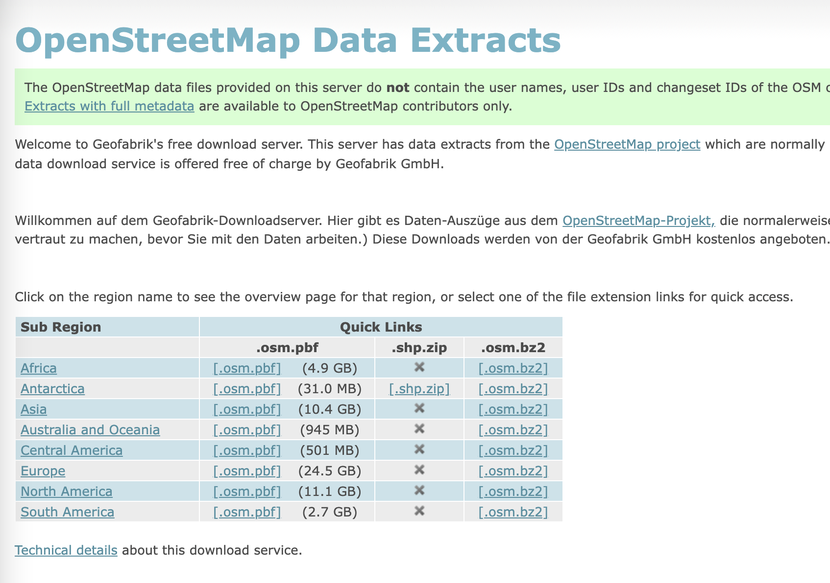
Spatial Data Can be Huge

Slide 3
Spatial Data Can be Heterogeneous
Fixed-site sensor data (e.g., traffic time series)
Moving data (e.g., trajectories)
Static data (e.g., road networks)
https://medium.com/analytics-vidhya/anomaly-detection-strategies-for-iot-sensors-6281e84263df

Slide 4




Scalable Data Integration & Analysis Architecture
Analytics
General
Data Processing
Integration
Storage
Streaming
Data Sources /Sensors
Stripelis, D., Ambite, J. L., Chiang, Y.-Y., Eckel, S. P., and Habre, R. (April 2017). A Scalable Data Integration and Analysis Architecture for Sensor Data of Pediatric Asthma, In Proceedings of the 2017 IEEE 33rd International Conference on Data Engineering (ICDE), pp. 1407-1408, San Diego, CA, USA

Slide 5
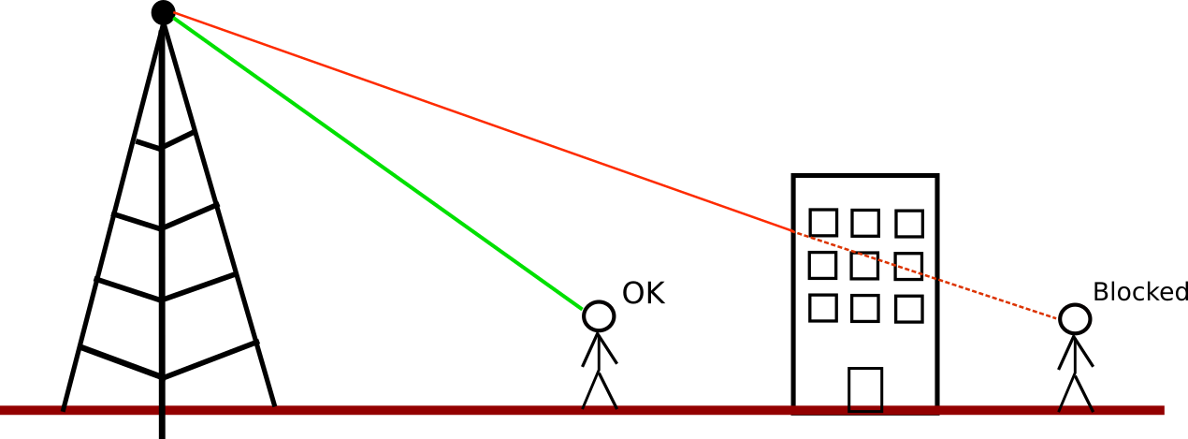
Analysis Requirements Can Vary
Real-time prediction of traffic using available traffic sensors and historical data from the last 10 years
Real-time and offline trajectory mining from large amount of trajectories
e.g., next point-of-interest recommendation, moving behavior detection
Offline line-of-sight analysis of cellphone towers for the entire US
https://github.com/spatial-computing/line-of-sight-analysis

Slide 6
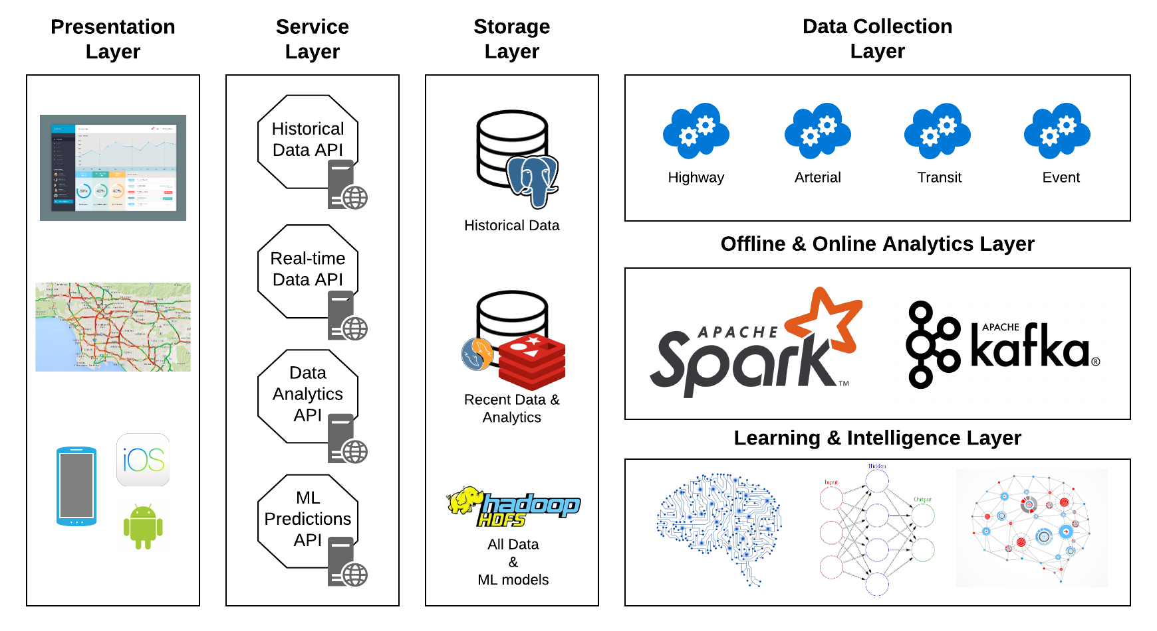
Archived Data Management System
Highway sensors
4500+
Arterial sensors
9500+
Bus & Rail sensors
2000+
Event
~400 per day
Ramp meter
CMS
Anastasiou, C., Lin, J., He, C., Chiang, Y.-Y., and Shahabi, C. (November 2019). ADMSv2: A Modern Architecture for Transportation Data Management and Analysis. In Proceedings of the 2nd ACM SIGSPATIAL International Workshop on Advances on Resilient and Intelligent Cities (ARIC 2019), pp. 25–28, Chicago, IL, USA

Slide 7

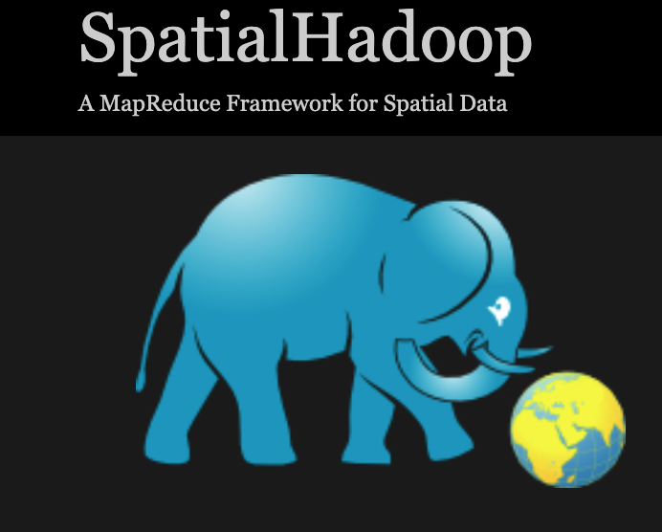

Spatial Big Data Platform
Like spatial databases, spatial Big Data platforms are software extensions on existing Big Data platforms
GeoSpark (Apache Sedona)
SpatialHadoop
GeoMesa
Use A Common Programming Model
MapReduce

Slide 8


MapReduce
A programming model for processing Big Data in a parallel distributed fashion
Many implementations
Apache Hadoop
Apache Spark

Slide 9
Acknowledgements
Gil, Yolanda (Ed.) Introduction to Computational Thinking and Data Science. Available from http://www.datascience4all.org

Slide 10

These materials are released under a CC-BY License
https://creativecommons.org/licenses/by/2.0/
You are free to:
Share — copy and redistribute the material in any medium or format
Adapt — remix, transform, and build upon the material
for any purpose, even commercially.
The licensor cannot revoke these freedoms as long as you follow the license terms.
Under the following terms:
Attribution — You must give appropriate credit, provide a link to the license,
and indicate if changes were made. You may do so in any reasonable manner,
but not in any way that suggests the licensor endorses you or your use.
Artwork taken from other sources is acknowledged where it appears.
Artwork that is not acknowledged is by the author.
Please credit as: Chiang, Yao-Yi Introduction to Spatial Artificial Intelligence. Available from https://yaoyichi.github.io/spatial-ai.html
If you use an individual slide, please place the following at the bottom: “Credit: https://yaoyichi.github.io/spatial-ai.html
We welcome your feedback and contributions.
Credit: http://www.datascience4all.org/

